Slide 1
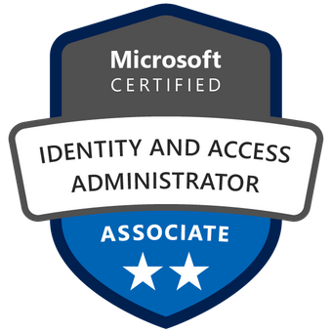
Exam SC-300: Microsoft Identity and Access Administrator Crash Course
Tim Warner

Slide 2

Tim Warner
Based in Nashville, TN, US
Central time zone
Senior Content Developer, Microsoft
MCT, former MVP
Twitter: @TechTrainerTim

Slide 3
Day 1 of 2 Agenda
Introduction
Azure AD identities (25%)
Authentication and access management (25%)

Slide 4
Day 2 of 2 Agenda
Content catch-up
Access management for applications (20%)
Azure AD identity governance (25%)
Exam SC-300 strategy

Slide 5
Course Materials
timw.info/sc300

Slide 6
Course Expectations
Please review the recordings…several times!
10-minute break at midpoint
I’m here to answer your questions – take advantage of this
Use the Q&A panel

Slide 7

Session Recordings

Slide 8

Session Recordings

Slide 9

Session Recordings

Slide 10


Mobile Browser: learning.oreilly.com

Slide 11



O'Reilly Mobile App

Slide 12
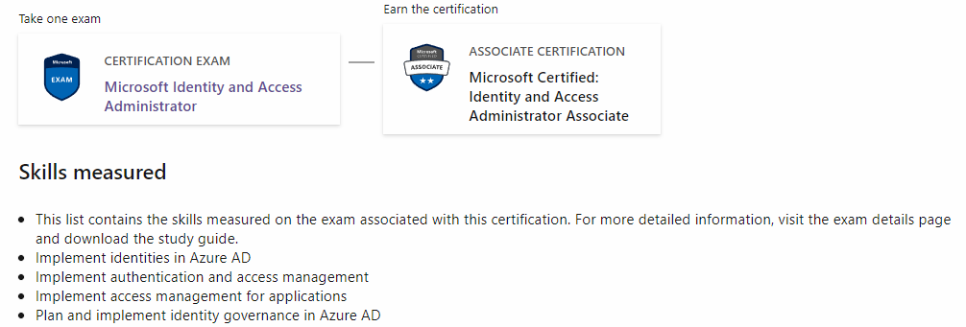
Identity & Access Admin Associate
SC-300

Slide 13
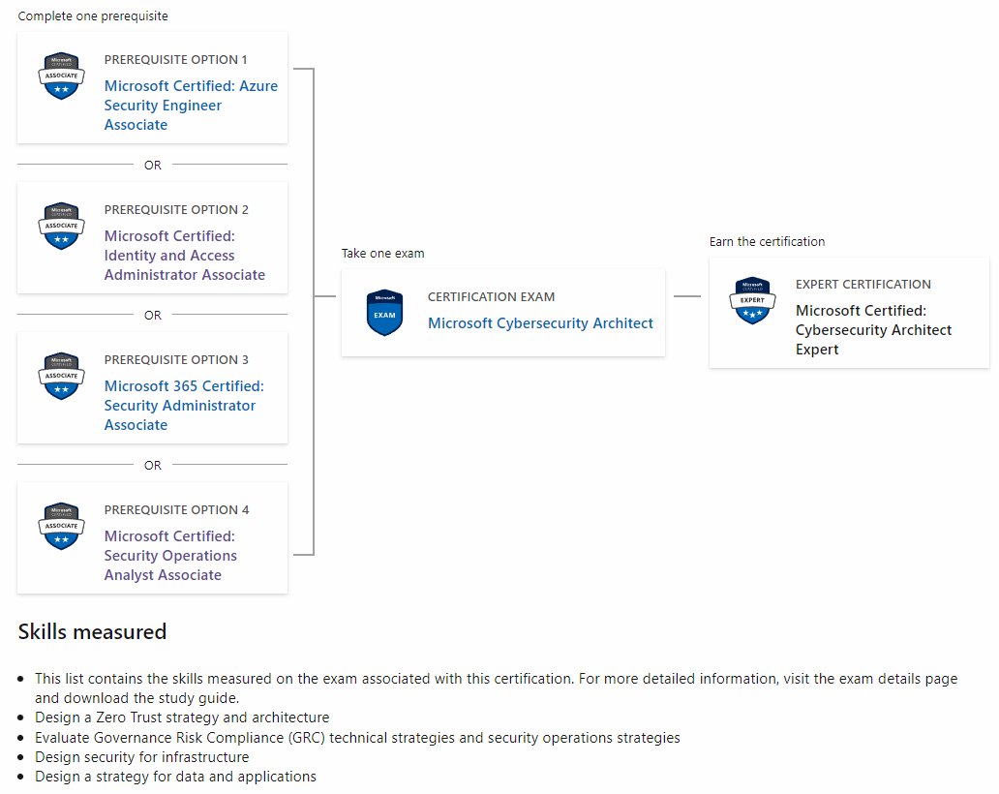
Cybersecurity Architect Expert
AZ-500
SC-100
MS-500

Slide 14
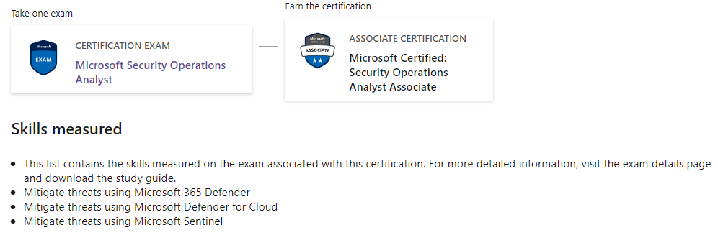
Security Operations Analyst Associate
SC-200

Slide 15
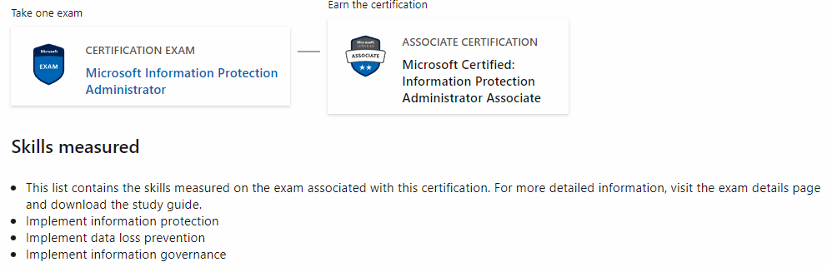
Information Protection Admin Assoc.
SC-400

Slide 16

Tim's Certification Study Model

Slide 17
Thank you!
Course materials: timw.info/sc300
Twitter: @TechTrainerTim
Pluralsight: timw.info/ps
Web: timw.info

Slide 18
Identity and Access

Slide 19
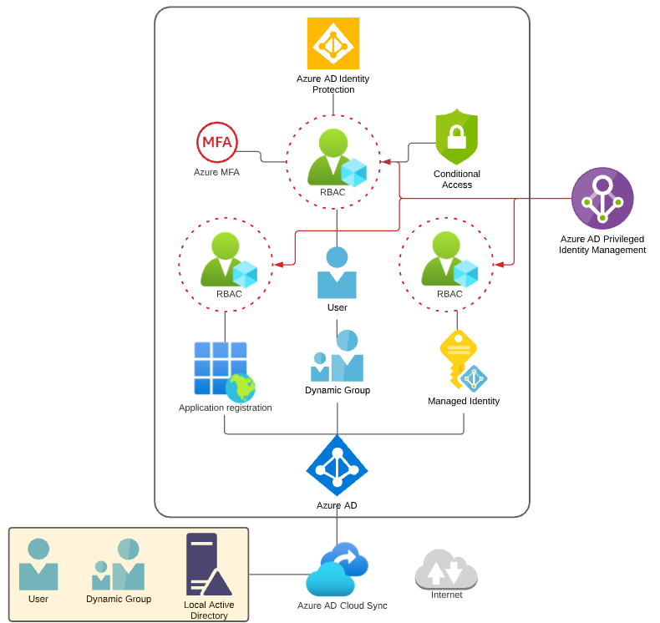
Identity and Access Scenario

Slide 20

Tenant vs. Subscription

Slide 21

Hybrid Identity

Slide 22

Azure Management Scopes
/ Tenant Root

Slide 23
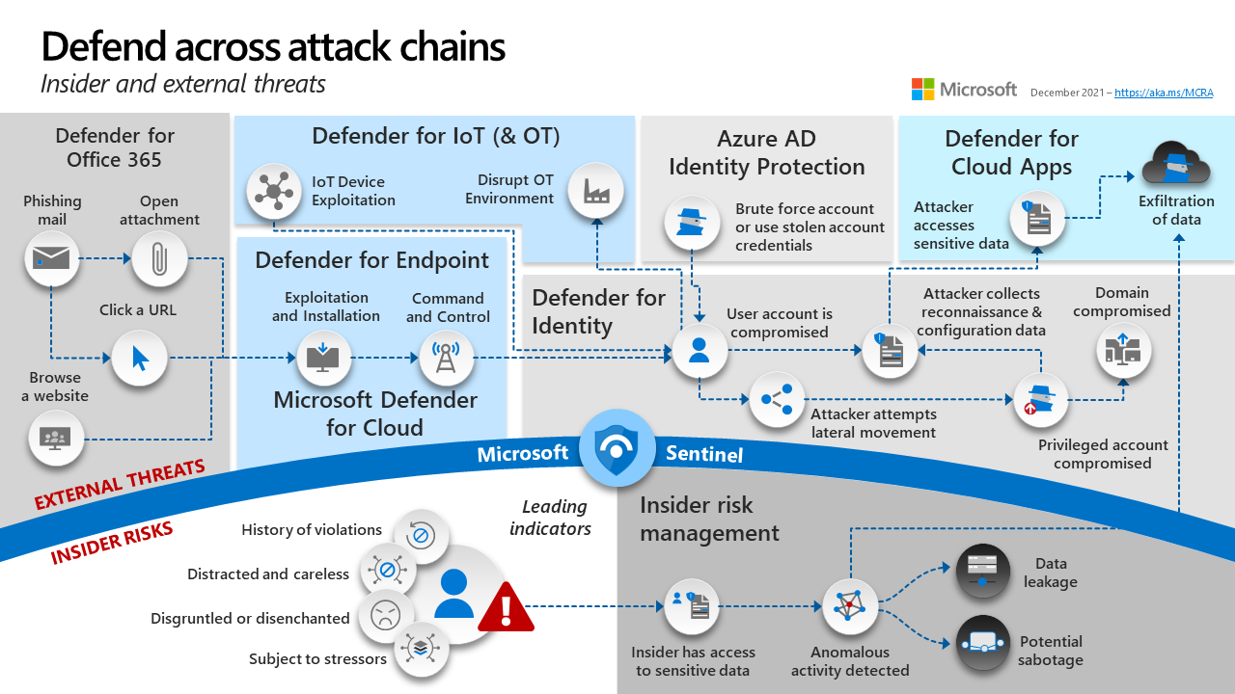
Microsoft 365 Defender

Slide 24
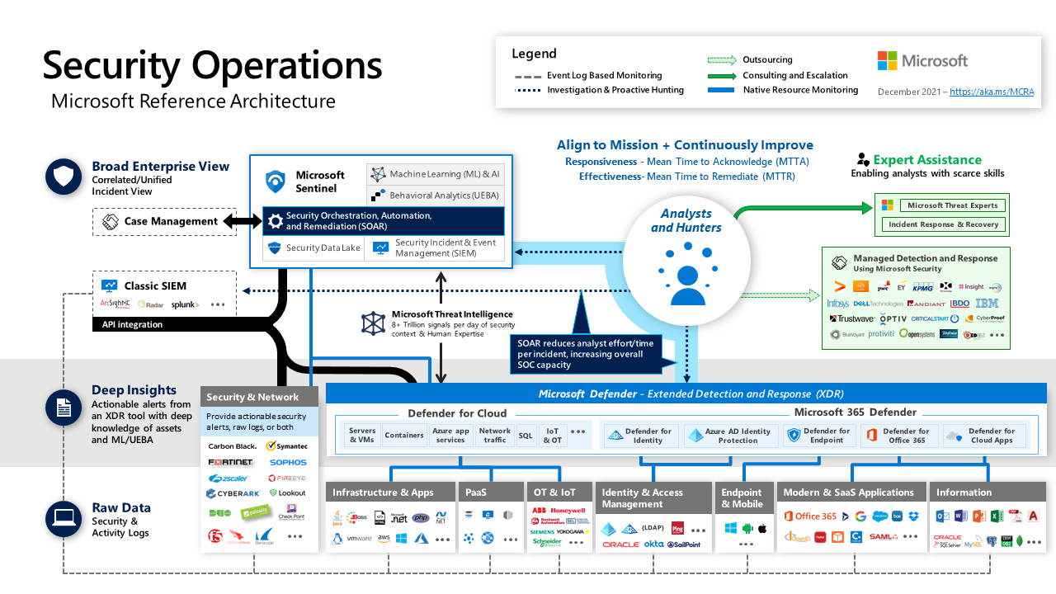
Microsoft 365 Defender in a Modern SOC

Slide 25



Identity Landscape at Microsoft
1) Zero Trust
Verify Explicitly
Use Least Privilege
Assume breach
2) Identity
Decentralize Providers
B2B
B2C
Verifiable Credentials
3) Actions
Authenticate – Prove – AuthN
Authorize – Get – AuthZ
Administer – Configure
Audit - Report
Continuous
Update
4) Usage
Secure ➔ Cryptography
Dollars ➔ Licenses
5) Maintain
Protect – Detect – Respond
Notes:
This slide is really a table of content of what is covered over the next 25 slides of this content. Do not drill into each of these topics, just use them as an introduction to what is coming.
Sample –
In this module we will soon be talking about Zero Trust and its principles of verify explicitly, using least privilege access, and always assuming you have been breached. Second identity can come from several sources. We will be discussing identity from Azure AD, but also from B2B and B2C sources, along with the new capability for verifiable credentials. Next you move on to the third section to talk about the actions that happen in an identity system of authentication, authorization, administration, and auditing. These actions allow used to securely use applications, and data. They also get the ability to perform cryptographic operations and the leverage licenses to access more services. Finally, we move to Protect, Detect, and Respond where we find any challenges in the system and continuously keep it up to date and evolving.

Slide 26

Zero Trust
Classify, label, encrypt
Data
Intersectional policy assessment (context, risk)
Identities
User requests access to resource
Microsoft Information Protection
Microsoft Azure AD
Resource directs to AAD for auth
Route through CASB
Apps
Azure AD Conditional Access
Policy enforcement
Apply controls and assess for anomalies
Verify explicitly
Use least privilege
Assume breach
Microsoft Defender for Cloud Apps
Infrastructure
Devices/ Endpoints
App and/or device health and security verified
Network security verified
Azure Networking
Intersectional risk assessment (threat intel, familiarity)
Microsoft Endpoint Manager
Intelligent and automation
Network
Microsoft Sentinel and Microsoft Defender XDR
Notes:
Talk track:
Our integrated set of solutions and capabilities offer built-in Zero Trust controls that make implementing a Zero Trust security model across your organization achievable at scale. Let’s walk through how all of the pieces work together.
At the heart of your Zero Trust strategy you need a policy engine to make dynamic access decisions for trusted users at critical checkpoints—access to networks, apps, and data. Our identity and access management and endpoint management solutions enables your organization to verify users and devices explicitly with rich signal, such as device health and sign-in risk, to make informed decisions based on access policies.
Our information protection and cloud security solutions help enforce decisions and protect resources across the entire environment in real time.
Our networking solutions help use real-time threat protection to detect and respond to threats across your networks and infrastructure.
Finally, our integrated security information and event management (SIEM) and extended detection and response (XDR) solutions to deliver true, end-to-end threat prevention, detection, and response. Together, Microsoft SIEM + XDR provide your organization visibility into threats across all your resources, stitch signal together to tell you what is most important and enable you to respond swiftly with integrated remediation capabilities.
Taken together, Microsoft’s intelligent security approach helps ensure that only the right people are getting the right level of access across your organization, elevating both security and end-user productivity.

Slide 27








Identity is the control plane
Notes:
First, we should probably answer the question - what is a control plane? A control plane is a term that has been used for years within networks. It is the part of a network that routes network traffic around the network architecture. So, a control plane is a tool or service that directs access to resources based on specific criteria. When it comes to solutions in today's world, the user is the right place to check for access. This sets up identity as the control plane.
With the many networks, devices, and applications needed in daily business, the only common denominator is the user. This is why we say, Identity is the control plane. It’s critical to establish who the user is as the core of trust for other transactions. If we aren’t sure who the user is, no other system access control or security matters. Once we are sure of the user, we can explicitly verify every element of access whether our resources are on-premises, in cloud-hosted servers, or managed by third-party SaaS apps like Office 365.

Slide 28
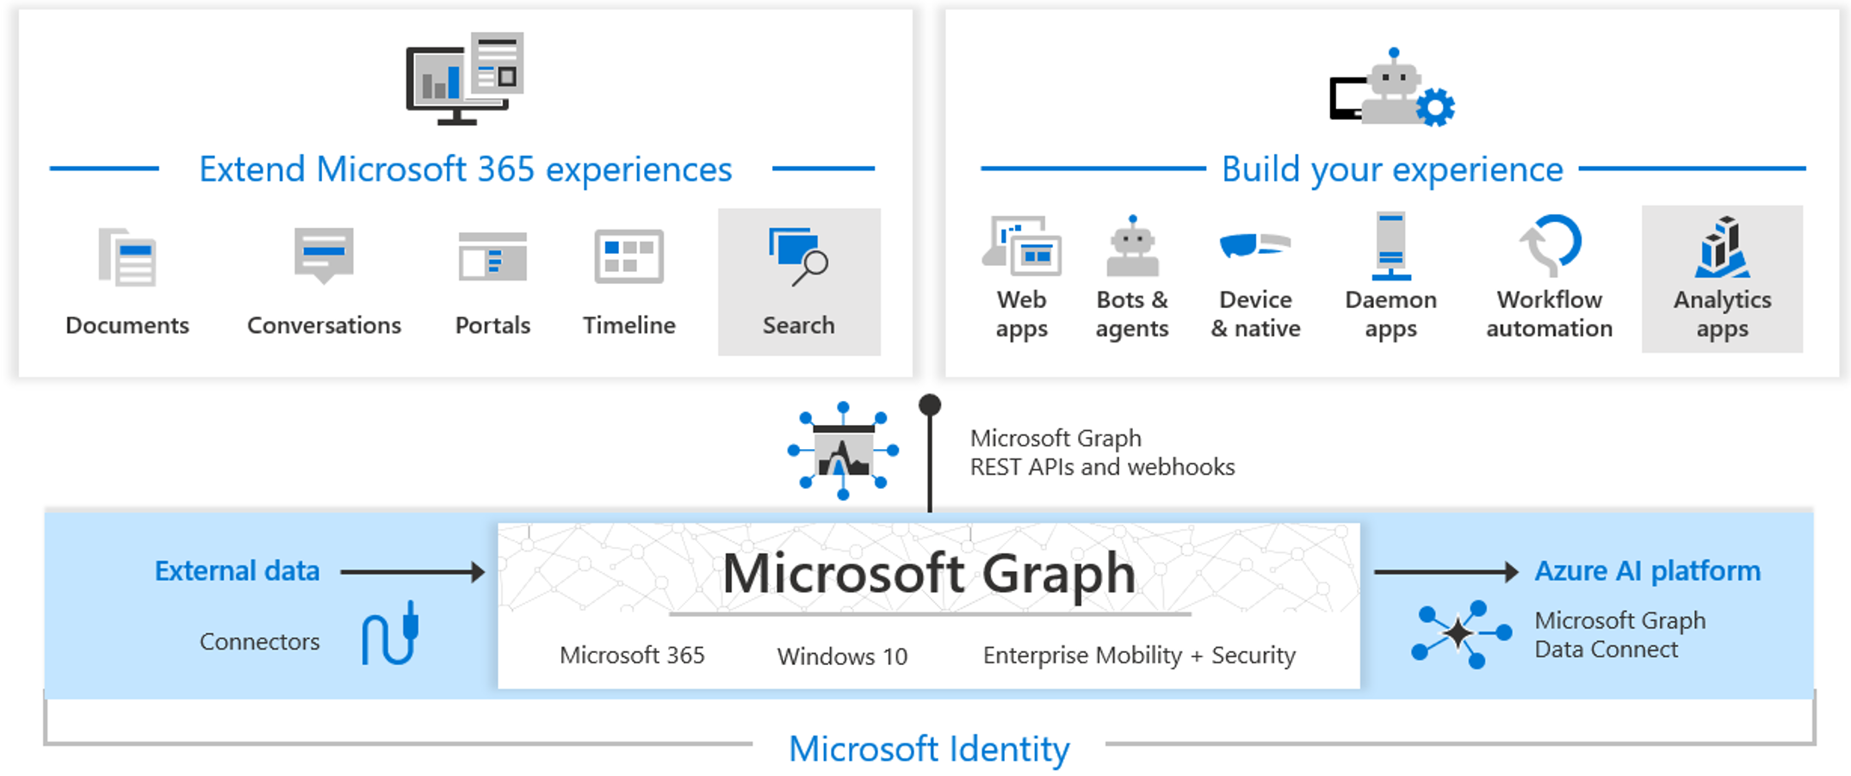
Microsoft Graph
Notes:
Microsoft Graph exposes REST APIs and client libraries to access data on the following Microsoft cloud services such as Azure AD, Microsoft 365, devices, and many others.
The Microsoft Graph API offers a single endpoint, https://graph.microsoft.com, to provide access to rich, people-centric data and insights in the Microsoft cloud, including Microsoft 365, Windows 10, and Enterprise Mobility + Security. You can use REST APIs or SDKs to access the endpoint and build apps that support Microsoft 365 scenarios, spanning across productivity, collaboration, education, people and workplace intelligence, and much more. Microsoft Graph also includes a powerful set of services that manage user and device identity, access, compliance, security, and help protect organizations from data leakage or loss.
Microsoft Graph connectors work in the incoming direction, delivering data external to the Microsoft cloud into Microsoft Graph services and applications, to enhance Microsoft 365 experiences such as Microsoft Search. Connectors exist for many commonly used data sources such as Box, Google Drive, Jira, and Salesforce.
Microsoft Graph Data Connect provides a set of tools to streamline secure and scalable delivery of Microsoft Graph data to popular Azure data stores. The cached data serves as data sources for Azure development tools that you can use to build intelligent applications.
Together, the Microsoft Graph API, connectors, and Data Connect power the Microsoft cloud services platform. With the ability to access Microsoft Graph data and other datasets, you can derive insights and analytics, extend Azure and Microsoft 365 by building unique, intelligent applications.

Slide 29








Cloud Adoption Framework – Identity Baseline
Define Corporate Policy
Business Risks | Policy & Compliance | Process
Document evolving business risks and risk tolerance; based on data classification and application criticality | Convert risk decisions into policy statements to establish cloud boundaries | Establish processes and monitor violations, along with adherence to corporate policy
Five Disciplines of Cloud Governance
Cost Management | Security Baseline | Resource Consistency | Identity Baseline | Deployment Acceleration
Evaluate & monitor costs, limit IT spend, scale to need, and cost accountability | Ensure compliance with IT security requirements by applying security baselines | Ensure consistency in resource configuration during on-boarding and recovery | Ensure baseline for identity and access are enforced by consistently applying role assignments | Accelerate deployment through centralization, consistency and standard templates
Identity Baseline discipline overview - Cloud Adoption Framework | Microsoft Docs

Slide 30
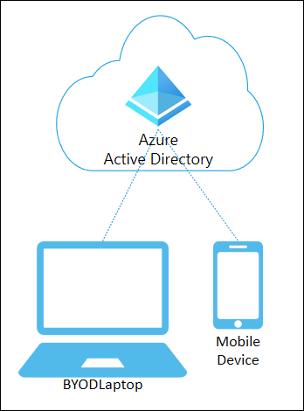
Azure AD-registered devices
Supports “BYOD” (bring your own device)
Registered devices sign in using a Microsoft account
Also attached to an Azure AD account granting access to organizational resources
Control using Mobile Device Management (MDM) tools like Microsoft Intune
OS – Windows 10, iOS, Android, and macOS
Notes:
What are Azure AD registered devices? | Microsoft Docs
Azure AD registered devices are signed in to using a local account like a Microsoft account on a Windows 10 device, but additionally have an Azure AD account attached for access to organizational resources. Access to resources in the organization can be further limited based on that Azure AD account and Conditional Access policies applied to the device identity.
Administrators can secure and further control these Azure AD registered devices using Mobile Device Management (MDM) tools like Microsoft Intune. MDM provides a means to enforce organization-required configurations like requiring storage to be encrypted, password complexity, and security software kept updated.
Azure AD registration can be accomplished when accessing a work application for the first time or manually using the Windows 10 Settings menu.

Slide 31
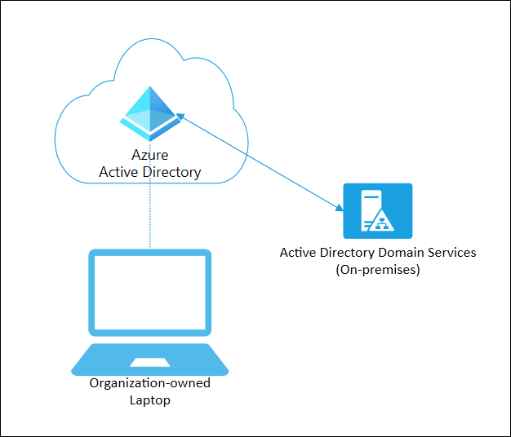
Azure AD joined devices
Intended for cloud-first or cloud-only organizations
Organization-owned devices
Joined only to Azure AD; organizational account required to sign in
Conditional Access policies can be applied to the device identity
OS – Windows 10 devices (not Home)
Notes:
What is an Azure AD joined device? | Microsoft Docs
Azure AD join is intended for organizations that want to be cloud-first or cloud-only. Any organization can deploy Azure AD joined devices no matter the size or industry. Azure AD join works even in a environment, enabling access to both cloud and on-premises apps and resources.
Azure AD joined devices are signed in to using an organizational Azure AD account. Access to resources in the organization can be further limited based on that Azure AD account and Conditional Access policies applied to the device identity.
Administrators can secure and further control Azure AD joined devices using Mobile Device Management (MDM) tools like Microsoft Intune or in co-management scenarios using Microsoft Endpoint Configuration Manager. These tools provide a means to enforce organization-required configurations like requiring storage to be encrypted, password complexity, software installations, and software updates. Administrators can make organization applications available to Azure AD joined devices using Configuration Manager.
Azure AD join can be accomplished using self-service options like the Out of Box Experience (OOBE), bulk enrollment, or Windows Autopilot.
Azure AD joined devices can still maintain single sign-on access to on-premises resources when they are on the organization's network. Devices that are Azure AD joined can still authenticate to on-premises servers like file, print, and other applications.

Slide 32
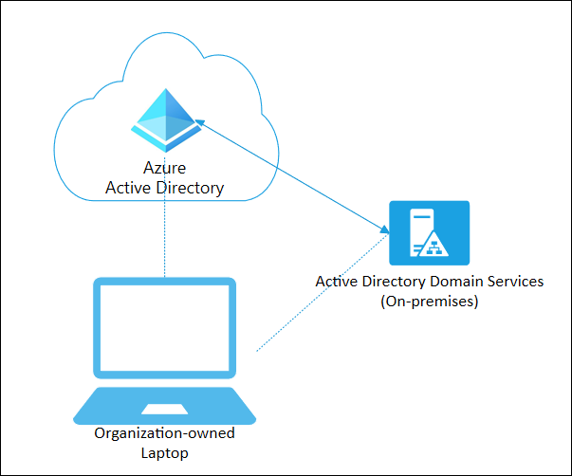
Hybrid Azure AD joined devices
Use Azure AD hybrid joined devices if:
You have Win32 apps deployed to these devices using Active Directory machine authentication
You want to continue to use Group Policy to manage the device
You want to use existing image solutions to deploy devices
OS - Windows 7 and 8.1 devices in addition to Windows 10
Notes:
What is a hybrid Azure AD joined device? | Microsoft Docs
For more than a decade, many organizations have used the domain join to their on-premises Active Directory to enable:
IT departments to manage work-owned devices from a central location.
Users to sign in to their devices with their Active Directory work or school accounts.
Typically, organizations with an on-premises footprint rely on imaging methods to provision devices, and they often use Configuration Manager or group policy (GP) to manage them.
If your environment has an on-premises AD footprint and you also want benefit from the capabilities provided by Azure Active Directory, you can implement hybrid Azure AD joined devices. These devices are devices that are joined to your on-premises Active Directory and registered with your Azure Active Directory.

Slide 33
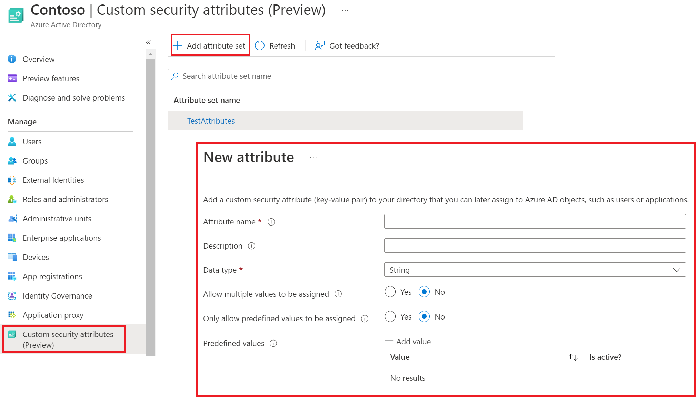
Manage custom security attributes (preview)
Notes:
https://docs.microsoft.com/en-us/azure/active-directory/fundamentals/custom-security-attributes-overview
Why use custom security attributes?
Extend user profiles, such as add Employee Hire Date and Hourly Salary to all my employees.
Ensure only administrators can see the Hourly Salary attribute in my employees' profiles.
Categorize hundreds or thousands of applications to easily create a filterable inventory for auditing.
Grant users access to the Azure Storage blobs belonging to a project.
What can I do with custom security attributes?
Define business-specific information (attributes) for your tenant.
Add a set of custom security attributes on users, applications, Azure AD resources, or Azure resources.
Manage Azure AD objects using custom security attributes with queries and filters.
Provide attribute governance so attributes determine who can get access.

Slide 34
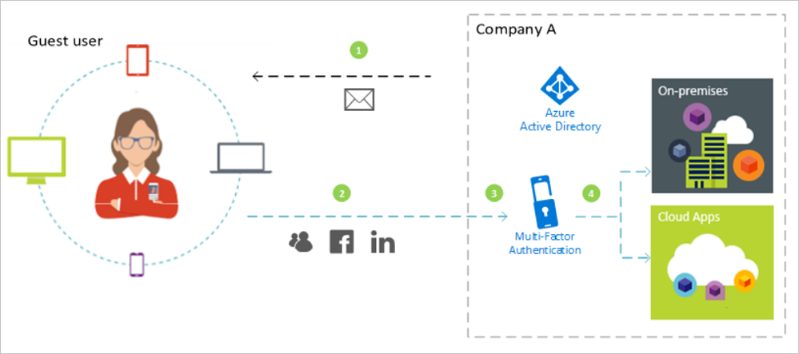
Azure Active Directory B2B
Notes:
Your organization needs to work with external users. To collaborate, these users need a required level of access to the applications. Azure AD B2B is a service that enables you to securely collaborate with external partners. Your partner users are invited as guest users. You remain in control of what they have access to, and for how long.
Numbers in the diagram:
1) Company sends and invite out to a guest user.
2) The Guest User responds to the invite and sets up the account - but remember this step depends on where the account originate (External Azure AD, Microsoft Account, On-Premises AD, or new guest account in local Azure AD).
3) This is showing that we can chose to add MFA to guest users for extra layers of security. A premium license is required to do this.
* We are saying that guest users have access to the resources that the administrator grants them; and based on the specific Authentication / Authorization rules defined. Similar to regular users. The difference is that you have a Membership type the identifies the user as External / Guest, which allows you to use specific RBAC, Conditional Access, and Policy rules to granularly control access.
4) Once the user is validated they are granted access to resources which could include on-premises resources. The validation is also impacted by where the account is homed (originates).

Slide 35
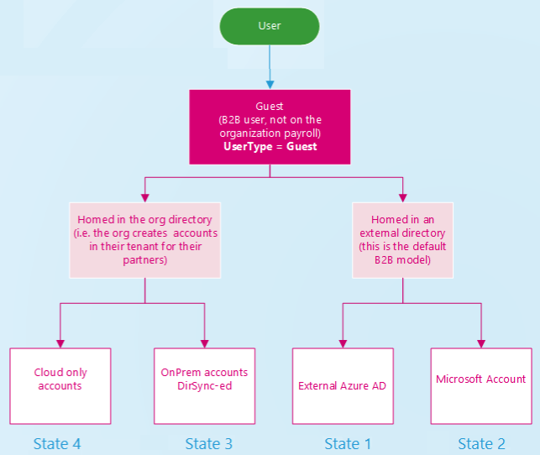
Azure AD B2B collaboration user states
Guest user state (origin) | Description
State 1 | Guest account in an External Azure AD
State 2 | Guest account is a Microsoft Account
State 3 | Guest account lives in on-premises Active Directory
State 4 | Guest account exist only in organizations Azure AD (Cloud only account)
Notes:
Depending on the inviting organization's needs, an Azure AD B2B collaboration user can be in one of the following account states:
State 1: Homed in an external instance of Azure AD and represented as a guest user in the inviting organization. In this case, the B2B user signs in by using an Azure AD account that belongs to the invited tenant. If the partner organization doesn't use Azure AD, the guest user in Azure AD is still created. The requirements are that they redeem their invitation and Azure AD verifies their email address. This arrangement is also called a just-in-time (JIT) tenancy or a "viral" tenancy.
State 2: Homed in a Microsoft or other account and represented as a guest user in the host organization. In this case, the guest user signs in with a Microsoft account or a social account (google.com or similar). The invited user's identity is created as a Microsoft account in the inviting organization’s directory during offer redemption.
State 3: Homed in the host organization's on-premises Active Directory and synced with the host organization's Azure AD. You can use Azure AD Connect to sync the partner accounts to the cloud as Azure AD B2B users with UserType = Guest. See Grant locally-managed partner accounts access to cloud resources.
State 4: Homed in the host organization's Azure AD with UserType = Guest and credentials that the host organization manages.

Slide 36
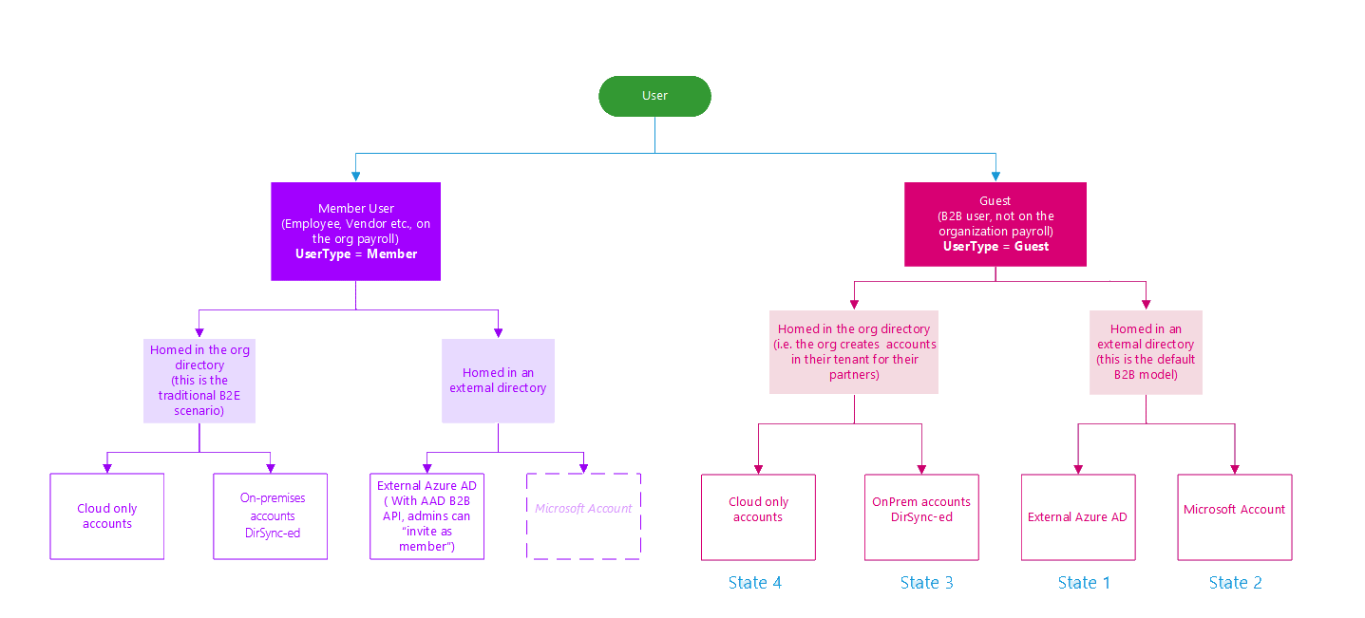
B2B user states
Notes:
B2B guest user objects in Azure AD have properties and states before and after invitation redemption. An Azure AD business-to-business (B2B) collaboration user is a user with UserType = Guest. This guest user typically is from a partner organization and has limited privileges in the inviting directory, by default.
Depending on the inviting organization's needs, an Azure AD B2B collaboration user can be in one of the following account states:
State 1: Homed in an external instance of Azure AD and represented as a guest user in the inviting organization. In this case, the B2B user signs in by using an Azure AD account that belongs to the invited tenant. If the partner organization doesn't use Azure AD, the guest user in Azure AD is still created. The requirements are that they redeem their invitation and Azure AD verifies their email address. This arrangement is also called a just-in-time (JIT) tenancy or a "viral" tenancy. Important: Starting March 31, 2021, Microsoft will no longer support the redemption of invitations by creating unmanaged Azure AD accounts and tenants for B2B collaboration scenarios. In preparation, we encourage customers to opt into email one-time passcode authentication. We welcome your feedback on this public preview feature and are excited to create even more ways to collaborate.
State 2: Homed in a Microsoft or other account and represented as a guest user in the host organization. In this case, the guest user signs in with a Microsoft account or a social account (google.com or similar). The invited user's identity is created as a Microsoft account in the inviting organization’s directory during offer redemption.
State 3: Homed in the host organization's on-premises Active Directory and synced with the host organization's Azure AD. You can use Azure AD Connect to sync the partner accounts to the cloud as Azure AD B2B users with UserType = Guest.
State 4: Homed in the host organization's Azure AD with UserType = Guest and credentials that the host organization manages.

Slide 37
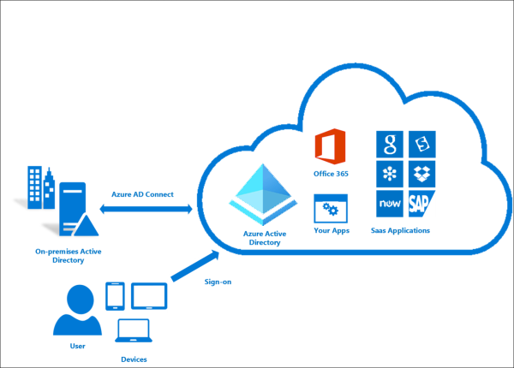
What is Azure Active Directory Connect?
Azure AD Connect is a solution that bridges an organizations on-premises Active Directory with your cloud-based Azure Active Directory
Azure Active Directory Connect provides:
Synchronization
Password hash synchronization
Pass-through authentication
Federation integration
Health monitoring
Notes:
Azure AD Connect is a solution that bridges an organizations on-premises Active Directory with your cloud-based Azure Active Directory. This allows IT to identities from on-premises into Azure and ensures a consistent identity across both platforms. This connection enables services like password hash synchronization, pass-through authentication, and seamless single sign-on.
Azure AD Connect is the Microsoft tool designed to meet and accomplish your hybrid identity goals. It provides the following capabilities:
Synchronization - Responsible for creating users, groups, and other objects. As well as, making sure identity information for your on-premises users and groups is matching the cloud. This synchronization also includes password hashes.
Password hash synchronization - A sign-in method that synchronizes a hash of a user's on-premises AD password with Azure AD.
Pass-through authentication - A sign-in method that allows users to use the same password on-premises and in the cloud, but doesn't require the additional infrastructure of a federated environment.
Federation integration - Federation is an optional part of Azure AD Connect and can be used to configure a hybrid environment using an on-premises AD FS infrastructure. It also provides AD FS management capabilities such as certificate renewal and additional AD FS server deployments.
Health monitoring - Azure AD Connect Health provides robust monitoring.

Slide 38
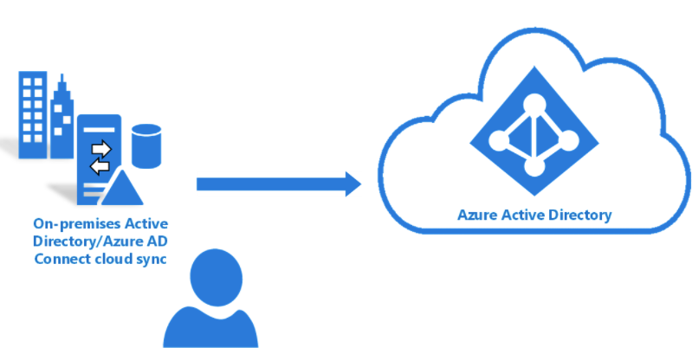
Azure AD Connect cloud sync
Azure AD Connect cloud sync is a solution syncs your on-premises AD with Azure AD
Lightweight provisioning agent required on the on-premises AD
All sync configuration is managed in the cloud
Can be used in conjunction with Azure AD Connect
Notes:
DOCS source content → What is Azure AD Connect cloud sync. | Microsoft Docs and Azure AD Connect cloud sync deep dive - how it works | Microsoft Docs
Cloud sync is built on top of the Azure AD services and has 2 key components:
Provisioning agent: The Azure AD Connect cloud provisioning agent is built on the same server-side technology as app proxy and Pass Through Authentication. It requires and outbound connection only and agents are auto-updated.
Provisioning service: Provisioning service uses a scheduler-based model. In case of cloud sync, the changes are provisioned every 2 mins.

Slide 39
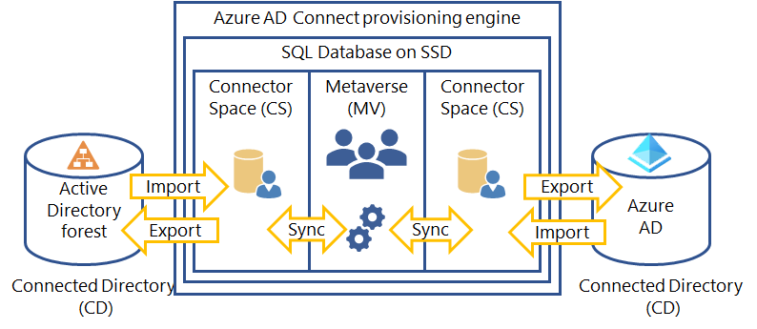
Azure AD Connect component factors
Notes:
The provisioning engine connects to each Active Directory forest and to Azure AD. The process of reading information from each directory is called Import. Export refers to updating the directories from the provisioning engine. Sync evaluates the rules of how the objects will flow inside the provisioning engine.
Azure AD Connect uses the following staging areas, rules, and processes to allow the sync from Active Directory to Azure AD:
Connector Space (CS) - Objects from each connected directory (CD), the actual directories, are staged here first before they can be processed by the provisioning engine. Azure AD has its own CS and each forest you connect to has its own CS.
Metaverse (MV) - Objects that need to be synced are created here based on the sync rules. Objects must exist in the MV before they can populate objects and attributes to the other connected directories. There's only one MV.
Sync rules - They decide which objects will be created (projected) or connected (joined) to objects in the MV. The sync rules also decide which attribute values will be copied or transformed to and from the directories.
Run profiles - Bundles the process steps of copying objects and their attribute values according to the sync rules between the staging areas and connected directories.

Slide 40
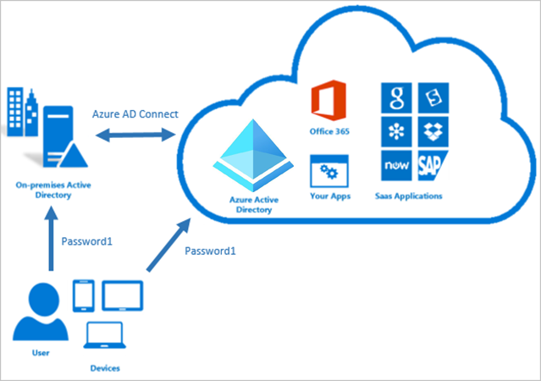
How password hash synchronization works
Notes:
Active Directory Domain Services stores passwords in the form of a hash value representation of the actual user password. A hash value is a result of a one-way mathematical function (the hashing algorithm). There is no method to revert the result of a one-way function to the plain text version of a password. To synchronize your password, Azure AD Connect sync extracts your password hash from the on-premises Active Directory instance. Extra security processing is applied to the password hash before it is synchronized to the Azure Active Directory authentication service. Passwords are synchronized on a per-user basis and in chronological order.

Slide 41

How Azure AD Pass-through Authentication works
Notes:
Azure Active Directory (Azure AD) Pass-through Authentication allows your users to sign in to both on-premises and cloud-based applications using the same passwords. This feature provides your users a better experience - one less password to remember, and reduces IT helpdesk costs because your users are less likely to forget how to sign in. When users sign in using Azure AD, this feature validates users' passwords directly against your on-premises Active Directory.

Slide 42

Single Sign-On
Notes:
Azure Active Directory Seamless Single Sign-On (Azure AD Seamless SSO) automatically signs users in when they are on their corporate devices connected to your corporate network. When enabled, users don't need to type in their passwords to sign in to Azure AD, and usually, even type in their usernames. This feature provides your users easy access to your cloud-based applications without needing any additional on-premises components.
Seamless SSO can be combined with either the Password Hash Synchronization or Pass-through Authentication sign-in methods. Seamless SSO is not applicable to Active Directory Federation Services (ADFS).

Slide 43
How Seamless SSO is set up
Seamless SSO is enabled using Azure AD Connect. While enabling the SSO, the following steps occur:
A computer account (AZUREADSSOACC) is created in your on-premises Active Directory (AD) in each AD forest that you synchronize to Azure AD (using Azure AD Connect).
In addition, a number of Kerberos service principal names (SPNs) are created to be used during the Azure AD sign-in process.
The computer account's Kerberos decryption key is shared securely with Azure AD. If there are multiple AD forests, each computer account will have its own unique Kerberos decryption key.
Notes:
The AZUREADSSOACC computer account needs to be strongly protected for security reasons. Only Domain Admins should be able to manage the computer account. Ensure that Kerberos delegation on the computer account is disabled, and that no other account in Active Directory has delegation permissions on the AZUREADSSOACC computer account.. Store the computer account in an Organization Unit (OU) where they are safe from accidental deletions and where only Domain Admins have access. The Kerberos decryption key on the computer account should also be treated as sensitive. We highly recommend that you roll over the Kerberos decryption key of the AZUREADSSOACC computer account at least every 30 days.

Slide 44
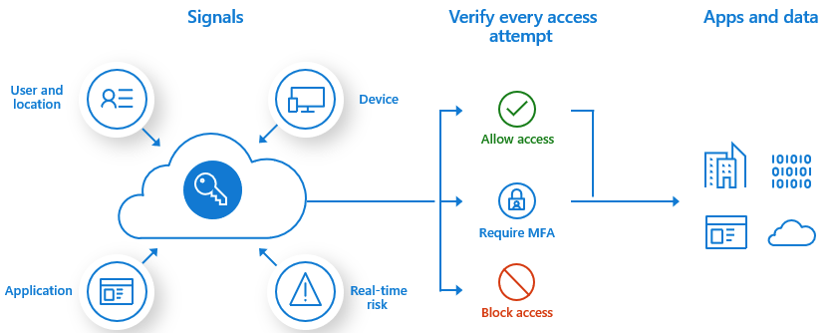
Enabling MFA with Conditional Access
Set up a Conditional Access policy that requires a user / group to have MFA required for access to specific resources.
Notes:
Enable Azure AD Multi-Factor Authentication | Microsoft Docs
Requirements before you can enable MFA:
A working Azure AD tenant with at least an Azure AD Premium P1 or trial license enabled.
If needed, create one for free.
An account with global administrator privileges. Some MFA settings can also be managed by an Authentication Policy Administrator. For more information, see Authentication Policy Administrator.
A non-administrator user with a password you know, such as testuser. You test the end-user Azure AD Multi-Factor Authentication experience using this account in this tutorial.
If you need to create a user, see Quickstart: Add new users to Azure Active Directory.
A group that the non-administrator user is a member of, such as MFA-Test-Group. You enable Azure AD Multi-Factor Authentication for this group in this tutorial.
If you need to create a group, see how to Create a group and add members in Azure Active Directory.

Slide 45




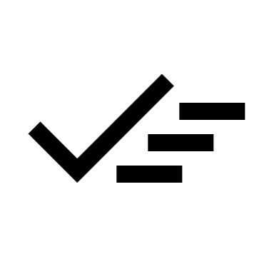

Azure AD self-service password reset
Users can reset their own password
 | No admin / IT intervention
Reduces the loss of user productivity
 | Reduces helpdesk efforts
Users must be enrolled first
 | Requires an assigned license
Notes:
Azure Active Directory (Azure AD) self-service password reset (SSPR) gives users the ability to change or reset their password, with no administrator or help desk involvement. If a user's account is locked or they forget their password, they can follow prompts to unblock themselves and get back to work. This ability reduces help desk calls and loss of productivity when a user can't sign in to their device or an application.
How does the password reset process work?
A user can reset or change their password using the SSPR portal. They must first have registered their desired authentication methods. When a user accesses the SSPR portal, the Azure platform considers the following factors:
How should the page be localized?
Is the user account valid?
What organization does the user belong to?
Where is the user's password managed?
Is the user licensed to use the feature?
When a user selects the Can't access your account link from an application or page, or goes directly to https://aka.ms/sspr, the language used in the SSPR portal is based on the following options:
By default, the browser locale is used to display the SSPR in the appropriate language. The password reset experience is localized into the same languages that Microsoft 365 supports.
If you want to link to the SSPR in a specific localized language, append ?mkt= to the end of the password reset URL along with the required locale.
For example, to specify the Spanish es-us locale, use ?mkt=es-us - https://passwordreset.microsoftonline.com/?mkt=es-us.
After the SSPR portal is displayed in the required language, the user is prompted to enter a user ID and pass a captcha. Azure AD now verifies that the user is able to use SSPR by doing the following checks:
Checks that the user has SSPR enabled and is assigned an Azure AD license.
If the user isn't enabled for SSPR or doesn't have a license assigned, the user is asked to contact their administrator to reset their password.
Checks that the user has the right authentication methods defined on their account in accordance with administrator policy.
If the policy requires only one method, check that the user has the appropriate data defined for at least one of the authentication methods enabled by the administrator policy.
If the authentication methods aren't configured, the user is advised to contact their administrator to reset their password.
If the policy requires two methods, check that the user has the appropriate data defined for at least two of the authentication methods enabled by the administrator policy.
If the authentication methods aren't configured, the user is advised to contact their administrator to reset their password.
If an Azure administrator role is assigned to the user, then the strong two-gate password policy is enforced. For more information, see Administrator reset policy differences.
Checks to see if the user's password is managed on-premises, such as if the Azure AD tenant is using federated, pass-through authentication, or password hash synchronization:
If SSPR writeback is configured and the user's password is managed on-premises, the user is allowed to proceed to authenticate and reset their password.
If SSPR writeback isn't deployed and the user's password is managed on-premises, the user is asked to contact their administrator to reset their password.
If all of the previous checks are successfully completed, the user is guided through the process to reset or change their password.

Slide 46
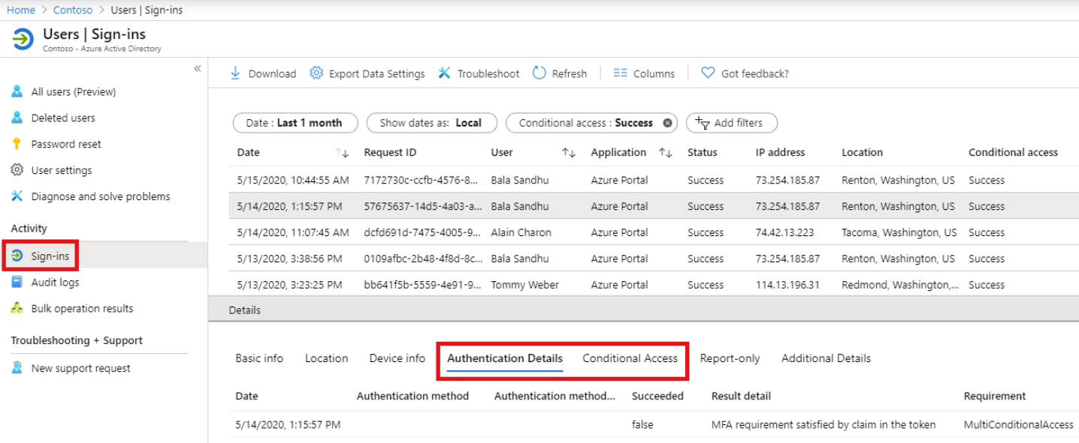
User – Sign-ins report
The Authentication Details or Conditional Access tab of the event details shows you the status code or which policy triggered the MFA prompt.
Notes:
The Authentication Details tab provides the following information, for each authentication attempt:
A list of authentication policies applied (such as Conditional Access, per-user MFA, Security Defaults)
The sequence of authentication methods used to sign-in
Whether or not the authentication attempt was successful
Detail about why the authentication attempt succeeded or failed

Slide 47
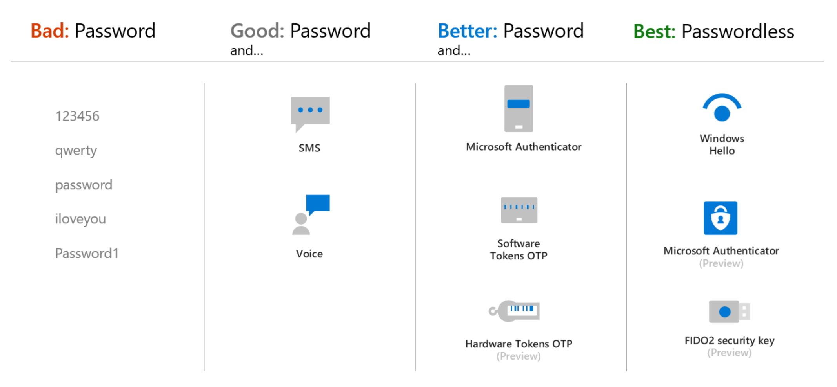
Authentication methods
Notes:
As part of the sign-in experience for accounts in Azure AD, there are different ways that users can authenticate themselves. Historically, a username and password is the most common way a user would provide credentials. With modern authentication and security features in Azure AD, that basic password should be supplemented or replaced with more secure authentication methods.

Slide 48
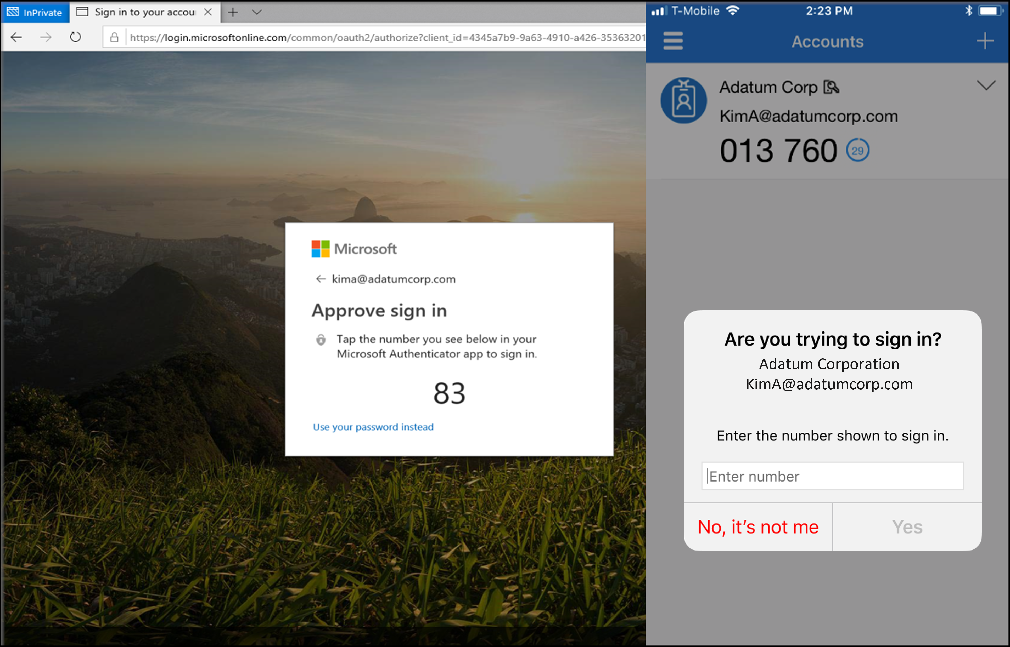
Microsoft Authenticator
Approve through mobile app – use a pin and or verify a number
Generate an OATH verification code – one-time code entered into sign-in UI
Enforce with policy and governance
Notes:
The Microsoft Authenticator app provides an additional level of security to your Azure AD work or school account or your Microsoft account and is available for Android and iOS. With the Microsoft Authenticator app, users can authenticate in a passwordless way during sign-in, or as an additional verification option during self-service password reset (SSPR) or Azure AD Multi-Factor Authentication events.
Users may receive a notification through the mobile app for them to approve or deny, or use the Authenticator app to generate an OATH verification code that can be entered in a sign-in interface. If you enable both a notification and verification code, users who register the Authenticator app can use either method to verify their identity.

Slide 49
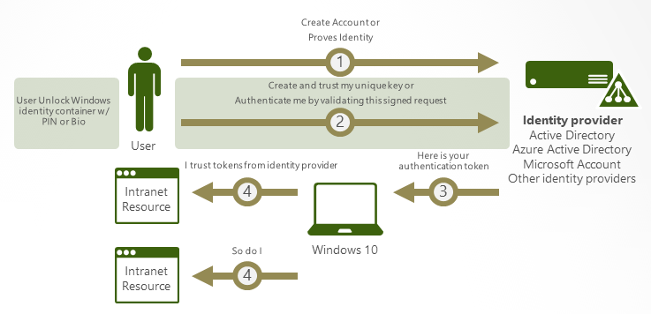
Authentication in Windows Hello
Notes:
In Windows 10, Windows Hello for Business replaces passwords with strong two-factor authentication on PCs and mobile devices. This authentication consists of a new type of user credential that is tied to a device and uses a biometric or PIN. Windows Hello for Business lets user authenticate to an Active Directory or Azure AD account.
Windows Hello addresses the following problems with passwords:
Strong passwords can be difficult to remember, and users often reuse passwords on multiple sites.
Server breaches can expose symmetric network credentials (passwords).
Passwords are subject to replay attacks.
Users can inadvertently expose their passwords due to phishing attacks.

Slide 50
Azure AD Password Protection
Users often create easy to guess passwords that are weak against dictionary-based attacks. To help you enforce strong passwords, Azure AD Password Protection provides a global and custom banned password list. Benefits include:
Domain controllers (DCs) never have to communicate directly with the internet
No new network ports
No AD DS schema changes required
No minimum AD DS domain or forest functional level (DFL/FFL) required
The software doesn't create or require accounts in the AD DS domains that it protects.
User clear-text passwords never leave the DC
The software isn't dependent on other Azure AD features
Incremental deployment is supported
Notes:
Azure AD Password Protection is designed with the following principles in mind:
Domain controllers (DCs) never have to communicate directly with the internet.
No new network ports are opened on DCs.
No AD DS schema changes are required. The software uses the existing AD DS container and serviceConnectionPoint schema objects.
No minimum AD DS domain or forest functional level (DFL/FFL) is required.
The software doesn't create or require accounts in the AD DS domains that it protects.
User clear-text passwords never leave the DC, either during password validation operations or at any other time.
The software isn't dependent on other Azure AD features. For example, Azure AD password hash sync (PHS) isn't related or required for Azure AD Password Protection.
Incremental deployment is supported, however the password policy is only enforced where the Domain Controller Agent (DC Agent) is installed.

Slide 51
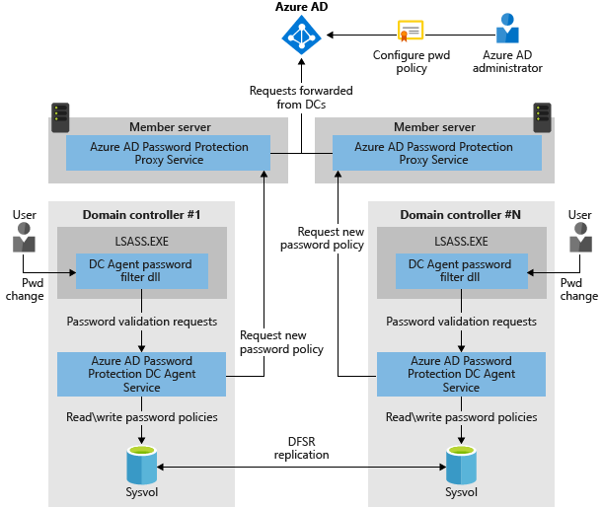
Deployment technology

Slide 52
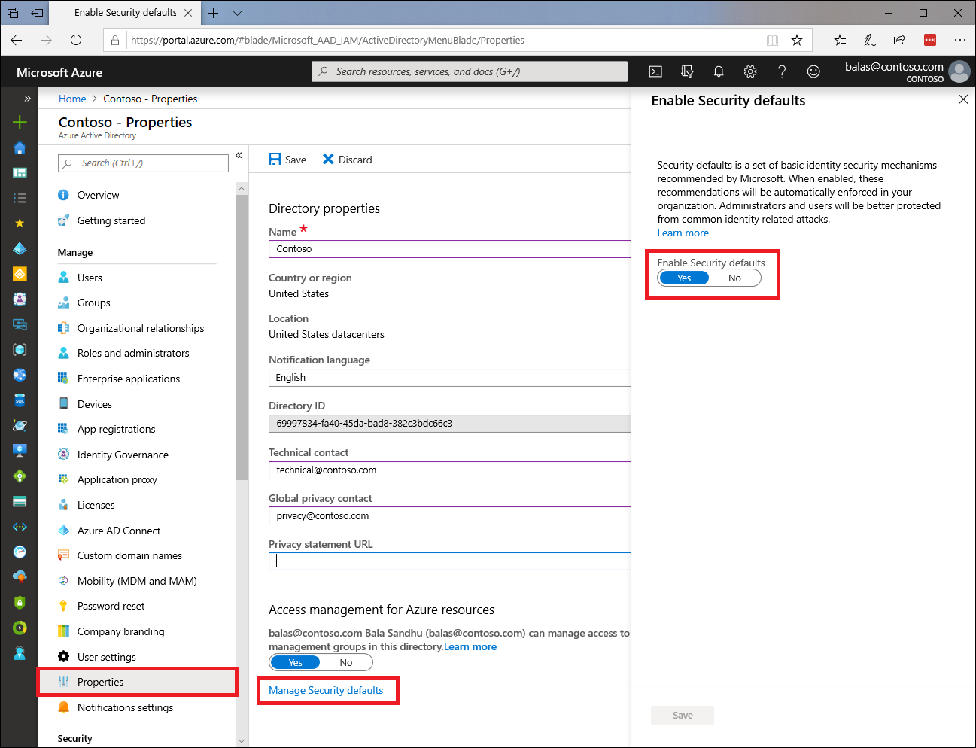
Security defaults
Notes:
Managing security can be difficult with common identity-related attacks like password spray, replay, and phishing becoming more and more popular. Security defaults provide secure default settings that Microsoft manages on behalf of organizations to keep customers safe until organizations are ready to manage their own identity security story. Security defaults provide preconfigured security settings, such as:
Requiring all users to register for Azure Active Directory multifactor Authentication.
Requiring administrators to perform multifactor authentication.
Blocking legacy authentication protocols.
Requiring users to perform multifactor authentication when necessary.
Protecting privileged activities like access to the Azure portal.

Slide 53
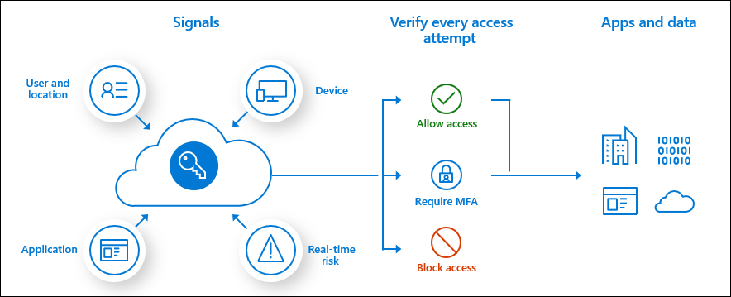
About conditional access policies
Notes:
Plan an Azure Active Directory Conditional Access Deployment | Microsoft Docs
CA policies are if-then statements: If an assignment is met, then apply these access controls. When configuring CA policies, conditions are called assignments. CA policies allow you to enforce access controls on your organization’s apps based on certain assignments.

Slide 54
Identity protection basics
Identity Protection is a service that enables organizations to view the security posture of any account.
Key tasks:
Automate the detection and remediation of identity-based risks.
Investigate risks using data in the portal.
Export risk detection data to third-party utilities for further analysis.
Notes:
Identity Protection uses the knowledge Microsoft has gained from its position in organizations with Azure AD, the consumer space with Microsoft Accounts, and in gaming with Xbox to protect your users. Microsoft analyzes 6.5 trillion signals per day to identify and protect customers from threats.
The signals generated by and fed to Identity Protection can be further fed into tools like Conditional Access to make access decisions or fed back to a security information and event management (SIEM) tool for further investigation based on your organization's enforced policies.
Covered in a later slide, but an Azure AD P2 license is required for Identity Protection in many cases.

Slide 55
Risk Detection, Remediation, and Investigation
Common risks detected and remediated
Anonymous IP address / Atypical travel
Malware-linked IP address
Unfamiliar sign-in properties
Leaked credentials
Password spray
Azure AD threat intelligence
New country
Suspicious inbox forwarding
Risk Investigation
Reports:
Risky users
Risky sign-ins
Risk detections
Risk levels – low / medium / high
Each level represents a higher likelihood that a user or sign-in is compromised
Notes:
Risk detection and remediation
Anonymous IP address: Sign in from an anonymous IP address (for example: Tor browser, anonymizer VPNs).
Atypical travel: Sign in from an atypical location based on the user's recent sign-ins.
Malware-linked IP address: Sign in from a malware-linked IP address.
Unfamiliar sign-in properties: Sign in with properties we've not seen recently for the given user.
Leaked credentials: Indicates that the user's valid credentials have been leaked.
Password spray: Indicates that multiple usernames are being attacked using common passwords in a unified brute-force manner.
Azure AD threat intelligence: Microsoft's internal and external threat intelligence sources have identified a known attack pattern.
New country: This detection is discovered by Microsoft Defender for Cloud Apps (MDfCA) (formerly - Microsoft Cloud App Security).
Activity from anonymous IP address: This detection is discovered by MDfCA.
Suspicious inbox forwarding: This detection is discovered by MDfCA.
The risk signals can trigger remediation efforts such as requiring users to: perform Azure AD Multi-Factor Authentication, reset their password using self-service password reset, or blocking until an administrator takes action.
Risk levels
Identity Protection categorizes risk into three tiers: low, medium, and high.
While Microsoft does not provide specific details about how risk is calculated, we will say that each level brings higher confidence that the user or sign-in is compromised. For example, something like one instance of unfamiliar sign-in properties for a user might not be as threatening as leaked credentials for another user.

Slide 56
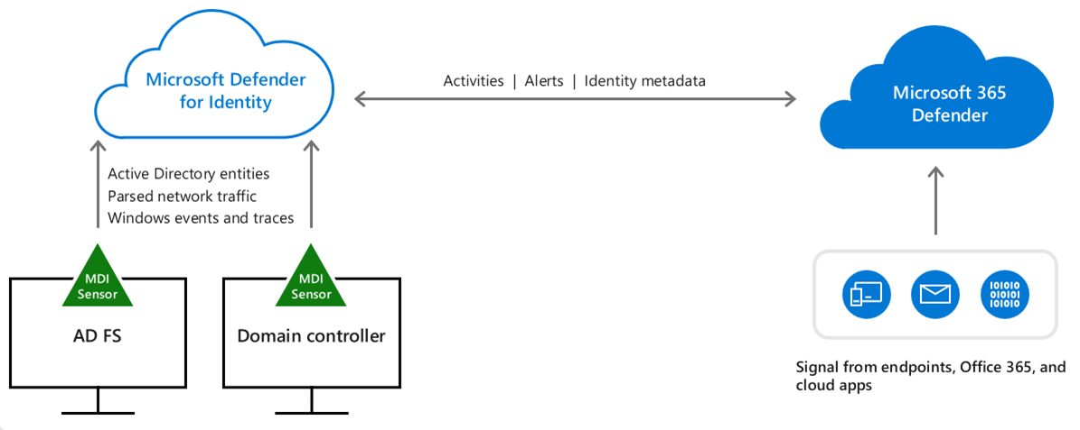
Microsoft Defender for Identity
Monitor users, entity behavior, and activities with learning-based analytics
Protect user identities and credentials stored in Active Directory
Identify and investigate suspicious user activities and advanced attacks throughout the kill chain
Provide clear incident information on a simple timeline for fast triage
Log into Defender for Identity = https://portal.atp.azure.com/
Notes:
Understanding the Microsoft Defender for Identity portal | Microsoft Docs

Slide 57
Key use cases for Permissions Management
Use case | Description
Discover | Customers can assess permission risks by evaluating the gap between permissions granted and permissions used.
Remediate | Customers can right-size permissions based on usage, grant new permissions on-demand, and automate just-in-time access for cloud resources.
Monitor | Customers can detect anomalous activities with machine language-powered (ML-powered) alerts and generate detailed forensic reports.
Notes:
Microsoft Entra Permissions Management (formerly known as CloudKnox) is a cloud infrastructure entitlement management (CIEM) solution. Permissions management provides comprehensive visibility into permissions assigned to all identities. Permissions Management detects, automatically right-sizes, and continuously monitors unused and excessive permissions.
Organizations have to consider permissions management as a central piece of their Zero Trust security to implement least privilege access across their entire infrastructure:
Organizations are increasingly adopting multi-cloud strategy and are struggling with the lack of visibility and complexity of managing access permissions.
With the proliferation of identities and cloud services, the number of high-risk cloud permissions is increasing. The increase expands the attack surface a bad actor can use to gain access.
IT security teams are under increased pressure to ensure access to their expanding cloud estate is secure and compliant.

Slide 58
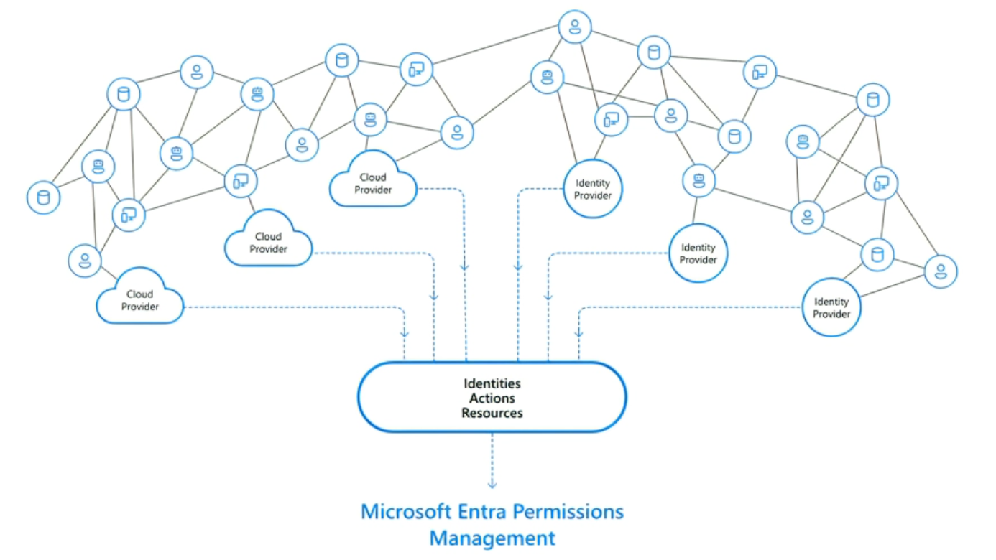
Permissions Management process flow
Notes:
Microsoft Entra Permissions Management comprehensive visibility into permissions assigned to all identities – users and workloads – actions, and resources across cloud infrastructures and identity providers. It detects, right-sizes, and monitors unused and excessive permissions and enables Zero Trust security through least privilege access in Microsoft Azure, AWS, and GCP.

Slide 59
What is CASB and Microsoft Defender for Cloud Apps (MDfCA)
CASB – Cloud Access Security Broker
A security tool placed between a cloud service (like an app) and the user to interject enterprise security policies before the cloud-based resource is accessed.
MDfCA – Microsoft Defender for Cloud Apps (formerly Cloud App Security)
Microsoft implementation of a CASB service to protect data, services, and applications with enterprise policies. It provides supplemental reporting and analytics services
Notes:
CASB = An on-premises or cloud-based security policy enforcement point, placed between cloud service consumers and cloud service providers to combine and interject enterprise security policies as the cloud-based resources are accessed.
MDfCA = Gain visibility into your cloud apps and services using sophisticated analytics to identify and combat cyberthreats. Control how your data is consumed, no matter where it lives. Microsoft Defender for Cloud Apps natively integrates with industry-leading security and identity solutions including Azure Active Directory, Intune, Microsoft Information Protection, and any other solutions you want to use.

Slide 60
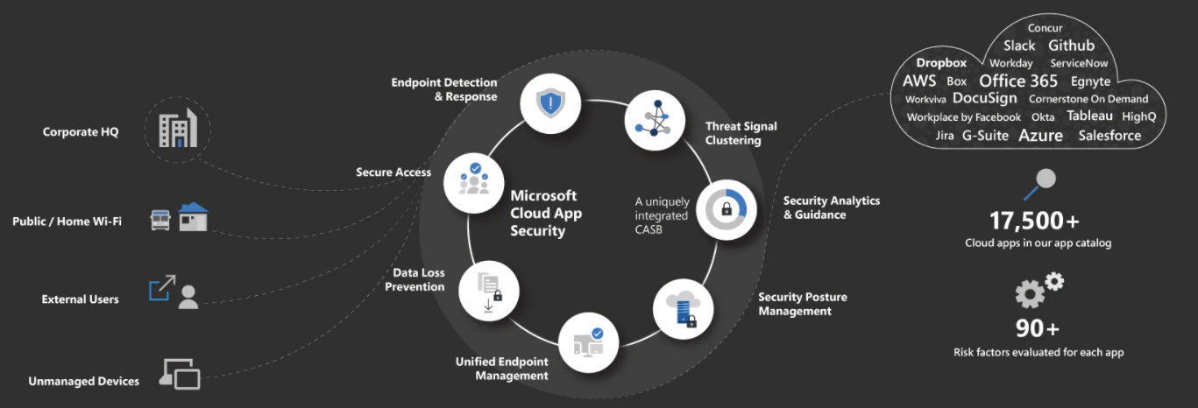
Microsoft Defender for Cloud Apps - Process Flow
Microsoft Defender for Cloud Apps
Notes:
A simple circular diagram shows how Zero Trust security uses an enforcement engine at its core, providing real-time policy evaluation. The engine delivers protection by analyzing signals, applying organization-wide policies and threat intelligence, and ensuring identities are verified and authenticated and devices are safe. It conditionally grants access to data, apps, infrastructure, and networks, providing continuous and comprehensive visibility, analytics, and automation.
MDfCA ebook - https://go.microsoft.com/fwlink/p/?LinkID=2079728&clcid=0x409&culture=en-us&country=US

Slide 61
MDfCA Capabilities
Shadow IT Discovery – find an manage cloud apps
Information Protection – protect information as it travels
Threat Protection – look for unusual behavior
Compliance Assessment – assess against regulatory requirements
Notes:
MDfCA = Microsoft Defender for Cloud Apps (formerly Microsoft Cloud App Security)
Discover and control the use of Shadow IT – On average more than 1,100 cloud applications are used by enterprises today, of which 61% are not sanctioned by IT. This results in duplicate capabilities, apps not meeting compliance standards or posing a security risk to the organization without any IT oversight. Discovery identifies current cloud apps, provides risk assessments and ongoing analytics and lifecycle management capabilities to control the use.
Protect data with Information Protection – To maximize the impact of information, it needs to be ubiquitous to help people and businesses succeed. With data being on the move, the risk for exposure increases, as sensitive data is overshared inside or even outside of the organization. Microsoft Defender for Cloud Apps enables you to identify your sensitive data across cloud apps, monitor when it is shared with risky environments and take necessary governance actions by classifying, labeling and protecting existing and new data in your environment.
Threat Protection against cyberthreats and anomalies - Moving to the cloud presents a new threat vector for organizations. Attacks can introduce ransomware, compromised user accounts perform malicious activities, and overprivileged O-auth apps can gain access to sensitive data or privileged accounts. Accelerate the safe adoption of cloud apps and limit the impact to your organization by leveraging sophisticated behavioral analytics, built-in detections and automatic remediation capabilities, informed by one of the industry’s largest set of threat signals.
Assess compliance of cloud resources – Most organizations must comply with a set of regulations, governed by the industry and country they operate in. These dictate how organizations must manage, view, and control their data. Microsoft Defender for Cloud Apps sources from a catalog of more than 16,000 cloud apps to discover the apps used in your environment and leverages >70 different parameters to assign a risk score to each one. These risk factors span general information, security, compliance and legal, and enable you to assess whether any given app meets the compliance requirements for your organization. Powerful, built-in queries allow you to filter for specific requirements such as GDPR or FedRAMP, to tailor the discovery experience to your specific needs.

Slide 62
Microsoft Defender for Cloud Apps
Cloud Access Security Broker (CASB)
Several different deployment modes:
Log collection
API connectors
Reverse proxy
Providing admins with:
Rich visibility
Data control
Sophisticated analytics
Identification of cyberthreats
Notes:
https://docs.microsoft.com/en-us/cloud-app-security/what-is-cloud-app-security
Microsoft Defender for Cloud Apps is a Cloud Access Security Broker (CASB) that supports various deployment modes including log collection, API connectors, and reverse proxy. It provides rich visibility, control over data travel, and sophisticated analytics to identify and combat cyberthreats across all your Microsoft and third-party cloud services.
Moving to the cloud increases flexibility for employees and IT alike. However, it also introduces new challenges and complexities for keeping your organization secure. To get the full benefit of cloud apps and services, an IT team must find the right balance of supporting access while maintaining control to protect critical data. Microsoft Defender for Cloud Apps is a Cloud Access Security Broker (CASB) that supports various deployment modes, including log collection, API connectors, and reverse proxy. It provides rich visibility, control over data travel, and sophisticated analytics to identify and combat cyberthreats across all your Microsoft and third-party cloud services. Microsoft Defender for Cloud Apps natively integrates with leading Microsoft solutions and is designed with security professionals in mind. It provides simple deployment, centralized management, and innovative automation capabilities. Microsoft Defender for Cloud Apps is a comprehensive cross-SaaS solution bringing deep visibility, strong data controls, and enhanced threat protection to your cloud apps. Cloud Discovery, a feature of Defender for Cloud Apps, enables you to gain visibility into Shadow IT by discovering cloud apps in use.

Slide 63

What is Application Proxy?
Feature to allow user to access on-premises application
Proxy service runs in the cloud and has an App Proxy Connector running on-premises
Securely passes sign-on tokens from Azure AD to the application
Notes:
Remote access to on-premises apps - Azure AD Application Proxy | Microsoft Docs
Application Proxy is a feature of Azure AD that enables users to access on-premises web applications from a remote client. Application Proxy includes both the Application Proxy service which runs in the cloud, and the Application Proxy connector which runs on an on-premises server. Azure AD, the Application Proxy service, and the Application Proxy connector work together to securely pass the user sign-on token from Azure AD to the web application.
Application Proxy works with:
Web applications that use Integrated Windows Authentication for authentication
Web applications that use form-based or header-based access
Web APIs that you want to expose to rich applications on different devices
Applications hosted behind a Remote Desktop Gateway
Rich client apps that are integrated with the Microsoft Authentication Library (MSAL)
Application Proxy supports single sign-on. For more information on supported methods, see Choosing a single sign-on method.
Application Proxy is recommended for giving remote users access to internal resources. Application Proxy replaces the need for a VPN or reverse proxy. It is not intended for internal users on the corporate network. These users who unnecessarily use Application Proxy can introduce unexpected and undesirable performance issues.

Slide 64

Value of Application Proxy
Protocol translation to / from Modern Authentication
Example - Convert Kerberos token to a modern auth token
Use seamless single-sign-on to remove user action to log in multiple times
Allows apps to stay on-premises (for whatever reason), but still be securely available to the user
Notes:
We have an AD DS integrated app (Kerberos) that we want to consume from the cloud world (modern token). AD proxy publishes the app out, but also takes care of the 'protocol translation'. Technical challenge is that the cloud identity needs to have a counterpart in the on-premises AD DS. So, for B2B users this will be a authentication challenge…how to get the cloud identity into the on prem AD DS.
To be complete you have Seamless SSO that provides us with the way to convert the authentication types. An on-premises user on an on-premises device wants to use a cloud apps, but we don't want the user to get another authentication challenge\response. Seamless SSO will translate the Kerberos based token to a modern token without bothering the user.
Typical real-world scenario - is mailbox migration from on-premises Exchange to M365 Exchange Online. After the migration users get a challenge response they did not get before (because the need to do AuthN with AAD and that does noet accept the AD DS Kerberos based token of the user).

Slide 65
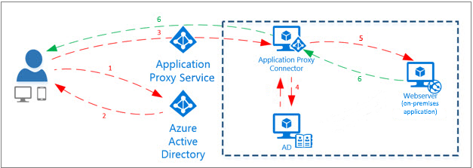
Application Proxy
Application Proxy is a feature of Azure AD that enables users to access on-premises web applications from a remote client
Notes:
The diagram shows how Azure AD and Application Proxy work together to provide single sign-on to on-premises applications.
After the user has accessed the application through an endpoint, the user is directed to the Azure AD sign-in page.
After a successful sign-in, Azure AD sends a token to the user's client device.
The client sends the token to the Application Proxy service, which retrieves the user principal name (UPN) and security principal name (SPN) from the token. Application Proxy then sends the request to the Application Proxy connector.
If you have configured single sign-on, the connector performs any additional authentication required on behalf of the user.
The connector sends the request to the on-premises application.
The response is sent through the connector and Application Proxy service to the user.

Slide 66
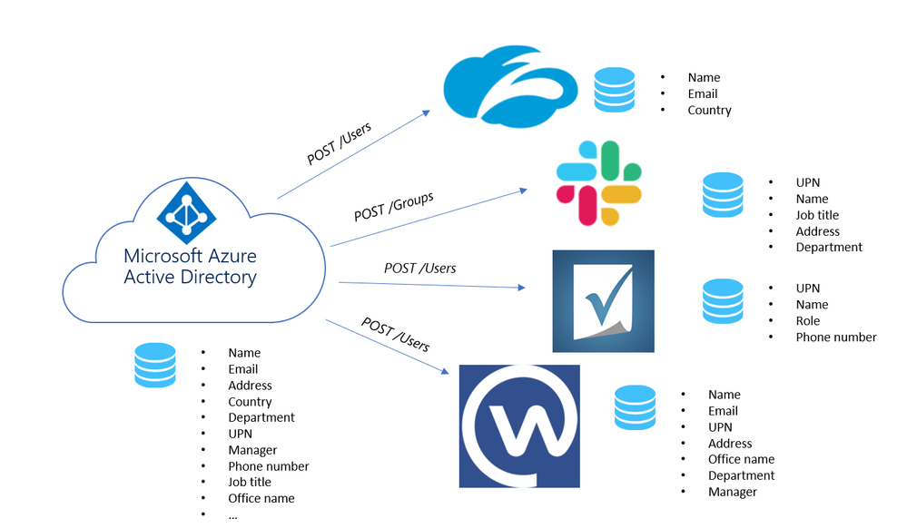
Azure AD SSO Integrations
Notes:
Tutorial - Develop a SCIM endpoint for user provisioning to apps from Azure Active Directory | Microsoft Docs
As an application developer, you can use the System for Cross-Domain Identity Management (SCIM) user management API to enable automatic provisioning of users and groups between your application and Azure AD. The SCIM specification provides a common user schema for provisioning. When used in conjunction with federation standards like SAML or OpenID Connect, SCIM gives administrators an end-to-end, standards-based solution for access management.

Slide 67
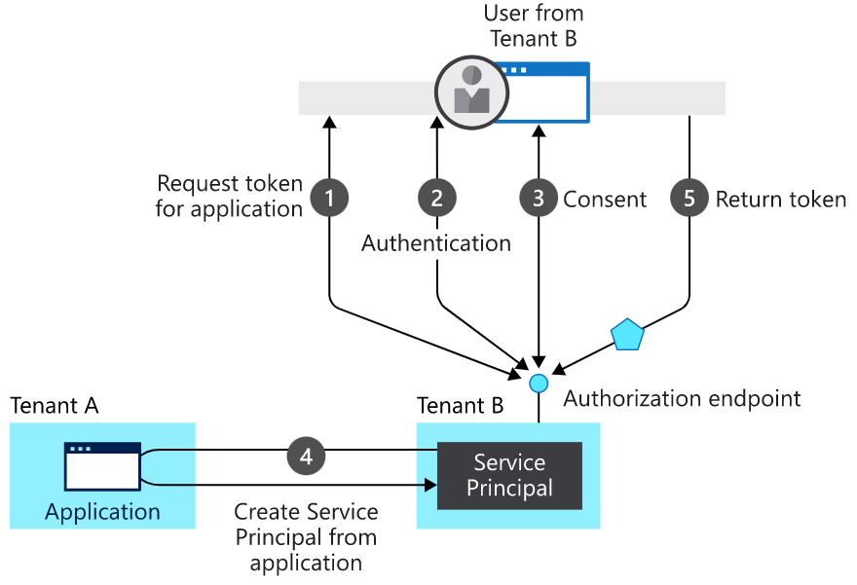
New app registration
Notes:
Process flow of the diagram
A user from tenant B attempts to sign in with the app. The authorization endpoint requests a token for the application.
The user credentials are acquired and verified for authentication.
The user is prompted to provide consent for the app to gain access to tenant B.
The Microsoft identity platform uses the application object in tenant A as a blueprint for creating a service principal in tenant B.
The user receives the requested token.

Slide 68
What is entitlement management?
Azure Active Directory (Azure AD) entitlement management is an identity governance feature that enables organizations to manage identity and access lifecycle at scale, by automating access request workflows, access assignments, reviews, and expiration.
Azure AD entitlement management can help you more efficiently manage access to groups, applications, and SharePoint Online sites for internal users, and also for users outside your organization who need access to those resources.
Notes:
What is entitlement management? - Azure AD | Microsoft Docs
Azure Active Directory (Azure AD) entitlement management is an identity governance feature that enables organizations to manage identity and access lifecycle at scale, by automating access request workflows, access assignments, reviews, and expiration.
Employees in organizations need access to various groups, applications, and sites to perform their job. Managing this access is challenging, as requirements change - new applications are added or users need additional access rights. This scenario gets more complicated when you collaborate with outside organizations - you may not know who in the other organization needs access to your organization's resources, and they won't know what applications, groups, or sites your organization is using.
Azure AD entitlement management can help you more efficiently manage access to groups, applications, and SharePoint Online sites for internal users, and also for users outside your organization who need access to those resources.
Why use entitlement management?
Enterprise organizations often face challenges when managing employee access to resources such as:
Users may not know what access they should have, and even if they do, they may have difficulty locating the right individuals to approve their access
Once users find and receive access to a resource, they may hold on to access longer than is required for business purposes
These problems are compounded for users who need access from another organization, such as external users that are from supply chain organizations or other business partners. For example:
No one person may know all of the specific individuals in other organization's directories to be able to invite them
Even if they were able to invite these users, no one in that organization may remember to manage all of the users' access consistently
Azure AD entitlemen

Slide 69
Summary of terminology
Term | Description
resource | An asset, such as an Office group, a security group, an application, or a SharePoint Online site, with a role that a user can be granted permissions to.
policy | A set of rules that defines the access lifecycle, such as how users get access, who can approve, and how long users have access through an assignment. A policy is linked to an access package. For example, an access package could have two policies: one for employees to request access and a second for external users to request access.
access package | A bundle of resources that a team or project needs and is governed with policies. An access package is always contained in a catalog. You would create a new access package for a scenario in which users need to request access.
catalog | A container of related resources and access packages. Catalogs are used for delegation so non-administrators can create their own access packages. Catalog owners can add resources they own to a catalog.

Slide 70
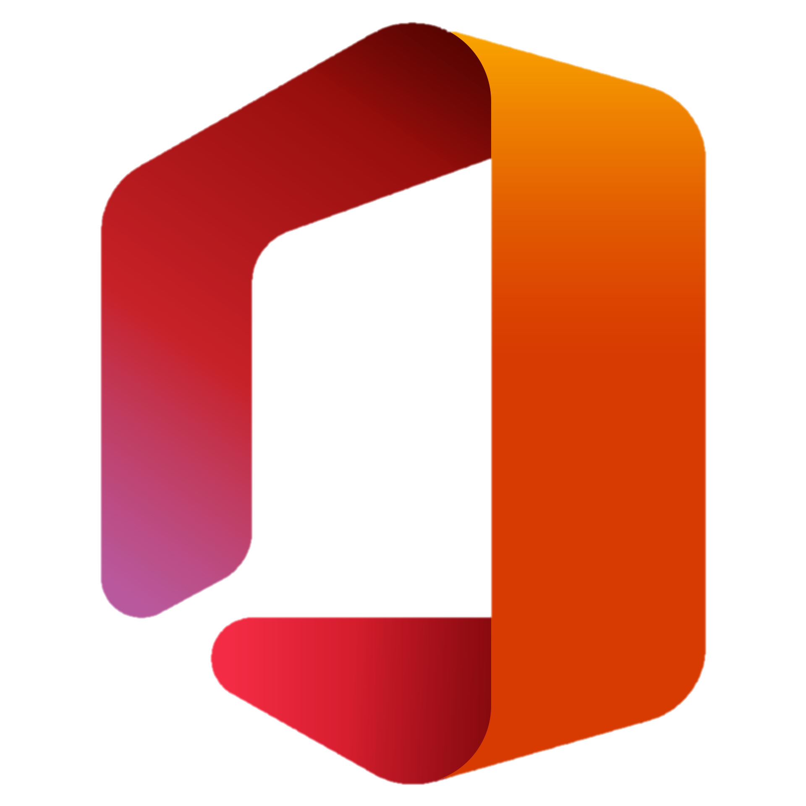

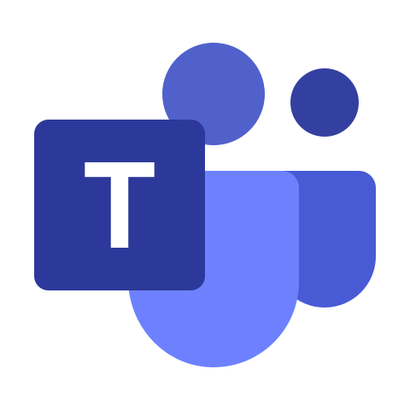
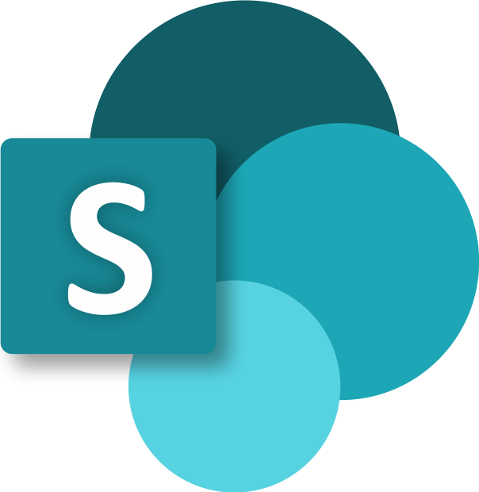
What are access packages?
An access package is list of resources like Groups, Apps, and Sites, along with the roles a user needs for those resources.
There is a policy included in the access package with rules for who can access the package.
Notes:
An access package is a bundle of resources with the access a user needs to work on a project or perform their task.
With an access package, you can manage:
Membership of Azure AD security groups.
Membership of Microsoft 365 Groups and Teams.
Assignment to Azure AD enterprise applications, including SaaS applications and custom-integrated applications that support federation/single sign-on and/or provisioning.
Membership of SharePoint Online sites.
You can also control access to other resources that rely upon Azure AD security groups or Microsoft 365 Groups. For example, you can provide:
Licenses for Microsoft 365 by using an Azure AD security group in an access package and configuring group-based licensing for that group.
Access to manage Azure resources by using an Azure AD security group in an access package and creating an Azure role assignment for that group.
Access to manage Azure AD roles by using groups assignable to Azure AD roles in an access package and assigning an Azure AD role to that group.

Slide 71




When should I use access packages?
Time-limited access
Manager approval
-or-
Delegated Role / Identity
Manage access without IT
Cross organization collaboration
Notes:
Access packages do not replace other mechanisms for access assignment. They are most appropriate in situations such as when:
Employees need time-limited access for a particular task. For example, you might use group-based licensing and a dynamic group to ensure all employees have an Exchange Online mailbox, and then use access packages for situations in which employees need additional access, such as to read departmental resources from another department.
Access requires the approval of an employee's manager or other designated individuals.
Departments wish to manage their own access policies for their resources without IT involvement.
Two or more organizations are collaborating on a project, and as a result, multiple users from one organization will need to be brought in via Azure AD B2B to access another organization's resources.

Slide 72
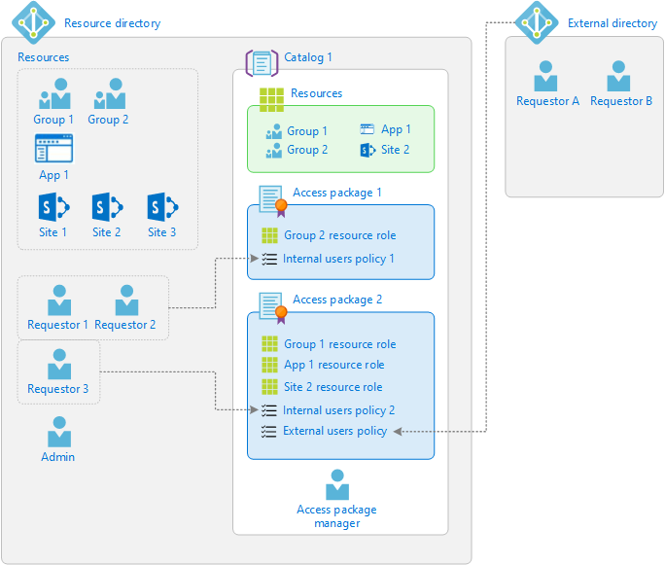
How do I control who get access?
Notes:
In Access package 1, there is only one single group as a resource. Access is defined with a policy that enables a set of users in the directory to request access. Access package 2 includes a group, an application, and a SharePoint Online site as resources. Access is defined with two different policies. The first policy enables a set of users in the directory to request access. The second policy enables users in an external directory to request access.

Slide 73
What is Privileged identity management?
PIM is a service in Azure Active Directory (Azure AD) that enables you to manage, control, and monitor access to important resources in your organization. Such resources include those in Azure AD, Azure, and other Microsoft Online Services, such as Microsoft 365 or Microsoft Intune

Slide 74
What does PIM do?
PIM provides time-based and approval-based role activation to mitigate the risks of excessive, unnecessary, or misused access permissions on resources that you care about. Key features of PIM include:
Provide just-in-time privileged access to Azure AD and Azure resources
Assign time-bound access to resources using start and end dates
Require approval to activate privileged roles
Enforce multifactor authentication to activate any role
Use justification to understand why users activate
Get notifications when privileged roles are activated
Conduct access reviews to ensure users still need roles
Download audit history for internal or external audit

Slide 75
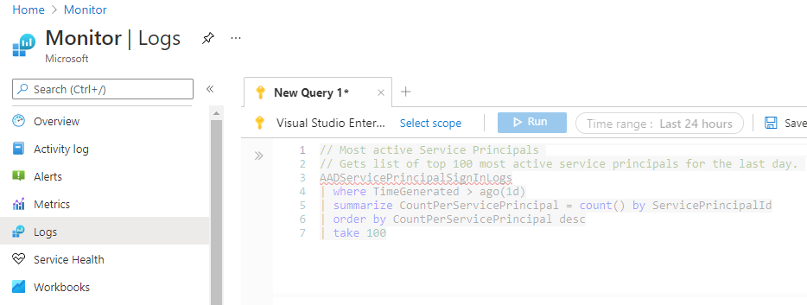
What is Log Analytics
Log Analytics is a tool in the Azure portal to edit and run log queries from data collected by Azure Monitor Logs and interactively analyze their results. You can use Log Analytics queries to retrieve records matching criteria, identify trends, analyze patterns, and provide a variety of insights into your data.

Slide 76
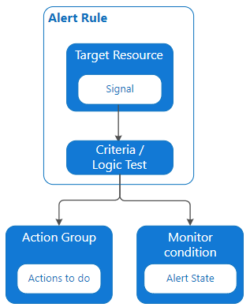
Azure Monitor Alerts
Alerts proactively notify you when issues are found with your infrastructure or application using your monitoring data in Azure Monitor.
Watch virtual machines, storage accounts, and other sources for events or thresholds.
Possible early warning of an attack
Set actions and alert to trigger when conditions are met.
Notes:
Target Resource - Defines the scope and signals available for alerting. A target can be any Azure resource. Example targets:
Virtual machines.
Storage accounts.
Log Analytics workspace.
Application Insights.
For certain resources (like virtual machines), you can specify multiple resources as the target of the alert rule.
Signal - Emitted by the target resource. Signals can be of the following types: metric, activity log, Application Insights, and log.
Criteria - A combination of signal and logic applied on a target resource. Examples:
Percentage CPU > 70%
Server Response Time > 4 ms
Result count of a log query > 100
Alert Name - A specific name for the alert rule configured by the user.
Alert Description - A description for the alert rule configured by the user.
Severity - The severity of the alert after the criteria specified in the alert rule is met. Severity can range from 0 to 4.
Sev 0 = Critical
Sev 1 = Error
Sev 2 = Warning
Sev 3 = Informational
Sev 4 = Verbose
Action - A specific action taken when the alert is fired. For more information, see Action Groups.

Slide 77
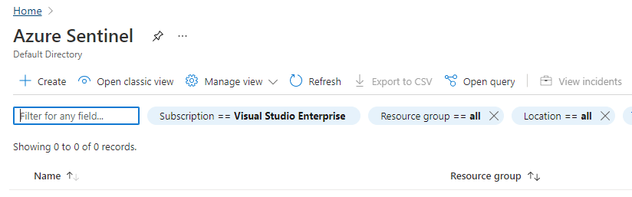
What is Microsoft Sentinel
Microsoft Sentinel is a scalable, cloud-native, security information event management (SIEM) and security orchestration automated response (SOAR) solution. Microsoft Sentinel is your birds-eye view across the enterprise alleviating the stress of increasingly sophisticated attacks, increasing volumes of alerts, and long resolution time frames.
Notes:
Microsoft Sentinel is a scalable, cloud-native, security information event management (SIEM) and security orchestration automated response (SOAR) solution. Microsoft Sentinel is your birds-eye view across the enterprise alleviating the stress of increasingly sophisticated attacks, increasing volumes of alerts, and long resolution time frames.
Collect data at cloud scale across all users, devices, applications, and infrastructure, both on-premises and in multiple clouds
Detect previously undetected threats, and minimize false positives using Microsoft's analytics and unparalleled threat intelligence
Investigate threats with artificial intelligence, and hunt for suspicious activities at scale, tapping into years of cyber security work at Microsoft
Respond to incidents rapidly with built-in orchestration and automation of common tasks

